Slide 1


26-1-R-18
Visual Language Models as Zero-Shot Deepfake Detectors
Nir Glick
Chen Tsafir
Students
207851155
319005104
Supervisors
Dr. Renata Avros
Prof. Zeev (Vladimir) Volkovich

Slide 2

Problem Definition
The Threat Deepfakes are becoming easy to create and hard to detect. This creates serious problems for identity verification, liveness checks and fraud prevention.
The Limitation Traditional detectors are trained on specific datasets. They work well on "seen" data and they fail on "unseen".
The Gap Traditional models struggle with new generation methods or simple image changes. they break when the image is compressed or noise is added.
Notes:
chen Let's start with the problem we are trying to solve. Today, anyone can create a deepfake using simple apps. This is a big problem for the security field, especially when we need to verify someone's identity online. The main issue is that current detection models are not 'smart' enough. They are like students who memorize the answers for a specific test. If you change the questions is similar to, use a new type of deepfake - they fail. Our goal is to find a solution that can detect fake images even if it has never seen that specific type of fake before.

Slide 3

Road Map
Problem Definition
1
2
How to Solve the Problem
Zero-Shot
3
Few-Shot
4
InstructBLIP
5
6
SBI
Flow-Chart Overview
7
8
Test Plan
Notes:
Chen

Slide 4
How to Solve the Problem
How can deepfakes that have never seen before can be detected?
The detector that should work without retraining.
It should still perform well on new, unseen deepfake styles.
It should also give a confidence score, not just “real” or “fake”.
Notes:
Nir
How can we detect deepfakes that we have never seen before, and get better performance?
Detector that does not need retraining
Robust model, new deepfakes appear daily
We want confidence score – not just yes and no answer to know how sure the model is
So, this leads us to the main question of our research: -How can we detect deepfakes that we have never seen before, and achieve better performance than traditional models?
First, we need a detector that works without retraining. In the real world, new deepfake apps appear every week. We cannot afford to retrain our model every single time a new app is released.
Second, the model must be robust. It needs to perform well even on new, unseen styles of manipulation that were not part of its original training data. And third, a simple 'Yes' or 'No' is not enough. We need a confidence score. For real-world security systems, like identity verification, we need to know how sure the model is sure about its decision, not just the final label.

Slide 5

The Solution: VLM-Based Probabilistic Detection
• The Innovation: Probabilistic Inference Algorithm.
◦ Extract token Probabilities for decision tokens ("Yes" / "No").
◦ Normalization: $P\left(Fake\right)= \frac{P_{no}}{P_{yes}+P_{no}}$ .
◦ Result: A continuous anomaly score, not just binary text.
Notes:
Nir
to solve this – we need probabilistic Inference algorithm
How do we do that? First, we ask 'Is this photo real?’.
we extract the raw confidence scores for the tokens 'Yes' and 'No’.
Then we normalize the values, meaning we convert a generative text model into probabilistic score
Gives us a score that is allowing us to detect deepfake based on semantic anomalies, not visual noise
To solve this, we developed a Probabilistic Inference Algorithm. We ask the model: 'Is this photo real?'. Instead of just reading the text answer, we extract the raw confidence scores—the token Probabilities —for the tokens 'Yes' and 'No'.
By normalizing these values, we convert a generative text model into a precise probabilistic classifier. This gives us a score, that is allowing us to detect deepfakes based on semantic anomalies rather than just visual noise."

Slide 6
Zero-Shot
Definition Performing a task without seeing any specific training examples for it.
Why VLMs? They are trained on internet-scale data, allowing them to understand general concepts.
Our Chosen Model: InstructBLIP • Why InstructBLIP? It is the best model and most advanced technology available right now, optimized with "Instruction Tuning". • The Advantage: It is specifically designed to follow instructions (like "Is this photo real?") better than standard models.
Notes:
chen to solve the problem of detecting new deepfakes We use an approach called 'Zero-Shot’. Imagine showing a picture to a person and asking, 'Is this real?’. They don't need to study thousands of fake photos beforehand to spot something weird. They just use their general knowledge.
We do the same thing with AI. We use large Visual Language Models that have seen so much data. For this project, we chose a specific model called InstructBLIP. We chose it because it uses a technique called 'Instruction Tuning'.

Slide 7
Few-Shot Learning
The Goal Teaching the model to detect specific new attacks using only a handful of examples (10% of data for training).
The Method – Smart fine tuning (PEFT - Parameter-Efficient Fine-Tuning)
Frozen: The "Brain“ (LLM) and "Eyes" (Image Encoder) are locked.
Trained: Q-Former (The connector) is the only component that is updated.
Key benefits • Speed: Training takes minutes, not days. • Safety: Prevents "forgetting" general knowledge.
• Performance: Achieves near-perfect accuracy on DFDC-P.
Notes:
Nir
Sometimes, Zero-Shot isn't enough, and we need the model to become an expert on a specific new type of deepfake quickly
Think of it like a human - if I show you just 3 or 4 examples of a specific glitch, you learn to spot it immediately
we want the model to do the same
To achieve, we use smart fine tuning, PEFT
We don’t train the whole ‘brain’ of the model again, we will train only a part that is called the q former, the bridge between the LLM and the Image encoder
allows to train the system on just 10% of the dataset—in a matter of minutes, achieving near-perfect detection results
Now, let's look at Few-Shot Learning.
Sometimes, Zero-Shot isn't enough, and we need the model to become an expert on a specific new type of deepfake very quickly.
Think of it like human learning: if I show you just 3 or 4 examples of a specific glitch, you learn to spot it immediately.
We want our model to do the same.
To achieve this without ruining the model's general intelligence, we use a strategy called Smart Fine-Tuning (or PEFT). Instead of retraining the whole massive brain of the model, we keep it frozen. We only update the Q-Former—the small part that connects vision to language.
This allows us to train the system on very little data—just 10% of the dataset—in a matter of minutes, achieving near-perfect detection results."

Slide 8
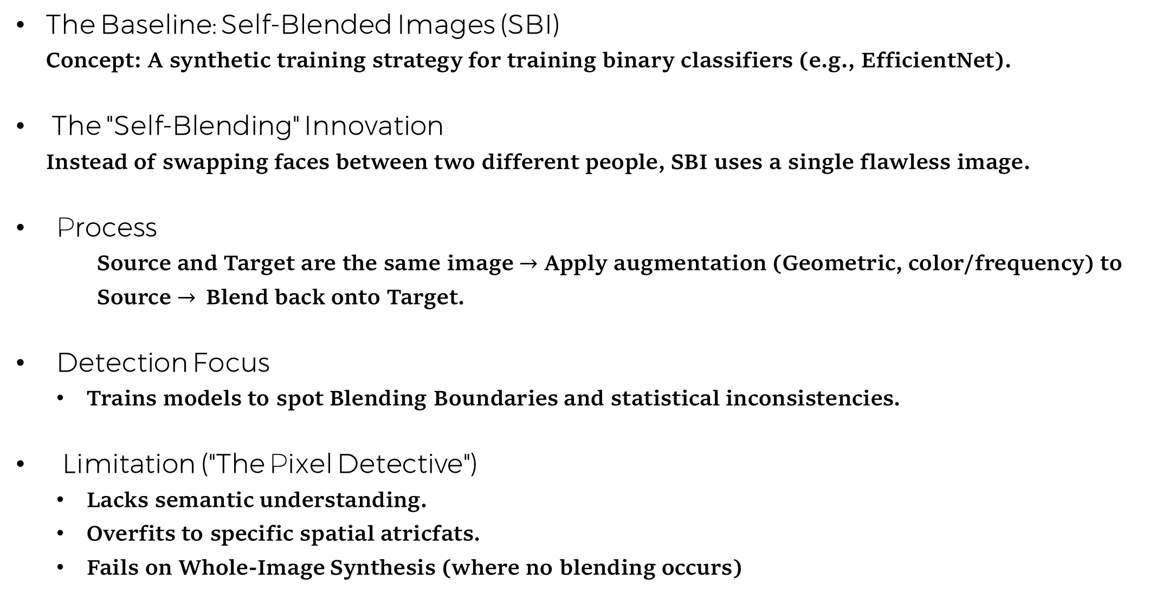
Traditional Detection SBI
The Baseline: Self-Blended Images (SBI) Concept: A synthetic training strategy for training binary classifiers (e.g., EfficientNet).
The "Self-Blending" Innovation Instead of swapping faces between two different people, SBI uses a single flawless image.
Process
Source and Target are the same image $→$ Apply augmentation (Geometric, color/frequency) to Source $→$Blend back onto Target.
Detection Focus
Trains models to spot Blending Boundaries and statistical inconsistencies.
Limitation ("The Pixel Detective")
Lacks semantic understanding.
Overfits to specific spatial atricfats.
Fails on Whole-Image Synthesis (where no blending occurs)
Notes:
Nir
The current state of the are traditional detector - Self-Blended Images, SBI
Unlike older methods that swapped faces between two different people, creating obvious mismatches, SBI is clever
It takes a single real photo, creates a copy, applies digital augmentations like color shifts or resizing to that copy, and then blends it back onto the original face.
Teaches the detectors to hunt for very specific artifacts, mainly blending boundaries and frequency inconsistencies.
The weakness – no semantic understanding, it does not understand the content of the image.
"Before showing our results, we must look at the current state-of-the-art in traditional detection: Self-Blended Images, or SBI.
Unlike older methods that swapped faces between two different people, creating obvious mismatches, SBI is clever. It takes a single real photo, creates a copy, applies digital augmentations like color shifts or resizing to that copy, and then blends it back onto the original face.
This teaches the detector to hunt for very specific artifacts, mainly blending boundaries and frequency inconsistencies. It is essentially a 'Pixel Detective'—it looks for the 'scars' left by the forgery process.
However, this is also its weakness. SBI relies on finding these specific pixel-level traces. It does not understand the content of the image.

Slide 9
InstructBLIP Goal & Core Idea
The Problem How can one model solve any visual task using simple text instructions?
The Challenge LLMs cannot see images, and standard vision models cannot understand complex instructions.
The Solution
Take a strong Image Encoder.
Take a strong LLM.
Freeze both of them (do not retrain them).
Train a small, smart "Bridge" (Q-Former) to connect them.
Key Concept Only the bridge learns how to pass information; the experts (vision and language) stay stable.
Notes:
Chen
How can we find model that can do any visual task just by following instructions? The challenge is that the 'brain' of AI - the Large Language Model - cannot see images. And the 'eyes’ - the Vision models - cannot talk. The core idea of InstructBLIP is simple but powerful. Instead of trying to retrain these huge models, we keep them frozen. We don't touch them. Instead, we build a small, flexible 'bridge' between them. We call this bridge the Q-Former. This bridge is the only part we train, teaching it to translate what the eyes see into something the brain can understand.

Slide 10
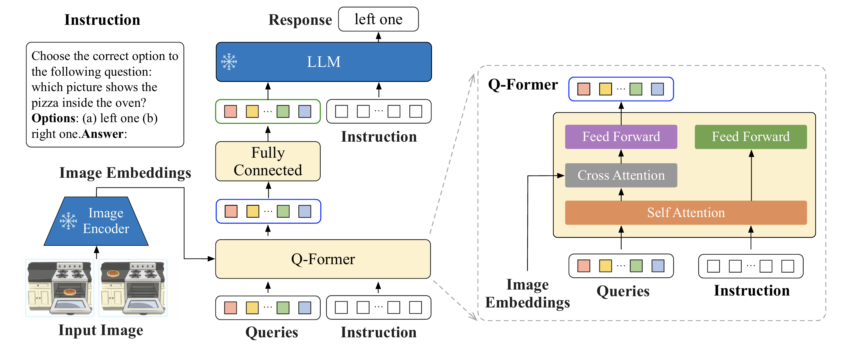
InstructBLIP Architecture
Inference Flow:
Image & Instruction enter the system.
The Image Encoder get the input image
Q-Former extracts specific visual features based on the instruction.
Linear Projection aligns features to the LLM.
LLM receives visual "soft prompts" + text to generate the answer.
Notes:
Chen Let's see how the flow of the architecture works, and in the next slides, we'll focus on each component in detail.

Slide 11
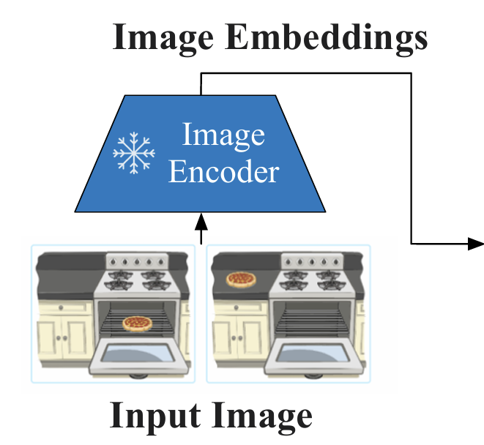
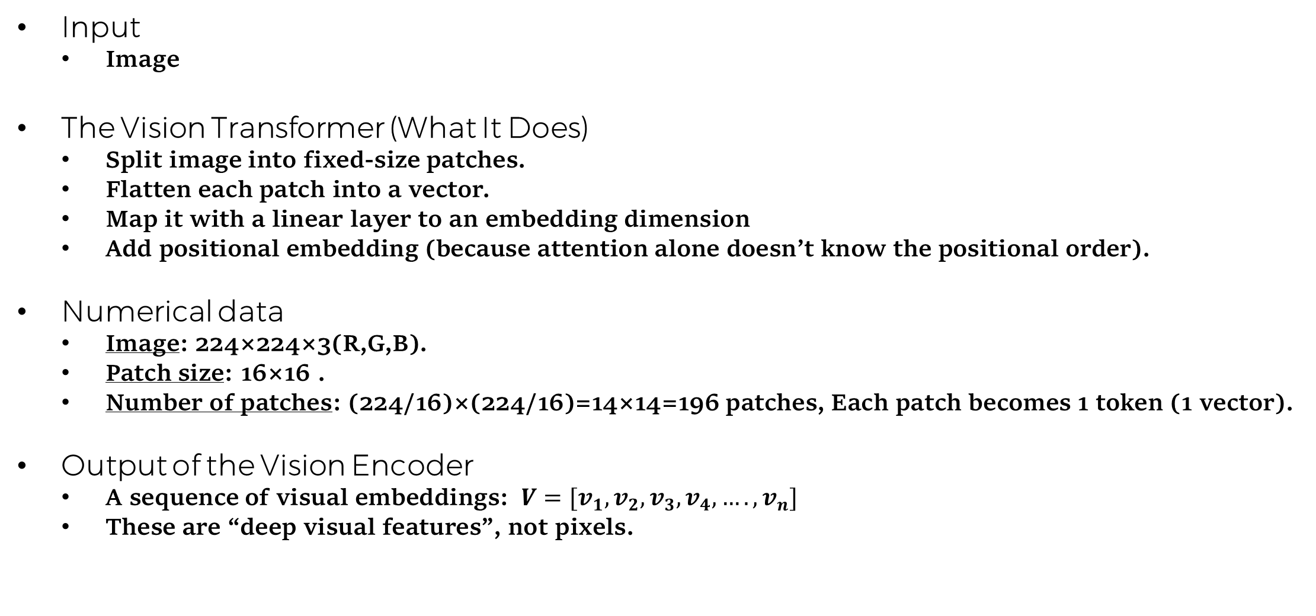
The Image Encoder
Input
Image
The Vision Transformer (What It Does)
Split image into fixed-size patches.
Flatten each patch into a vector.
Map it with a linear layer to an embedding dimension
Add positional embedding (because attention alone doesn’t know the positional order).
Numerical data
Image: 224×224×3(R,G,B).
Patch size: 16×16 .
Number of patches: (224/16)×(224/16)=14×14=196 patches, Each patch becomes 1 token (1 vector).
Output of the Vision Encoder
A sequence of visual embeddings: $V=[v_{1},v_{2},v_{3},v_{4},….,v_{n}]$
These are “deep visual features”, not pixels.
Notes:
Chen
איך הוא משטח כל פאץ'?
דמיין שחתכת ריבוע מהתמונה בגודל 16 X 16 פיקסלים. לכל פיקסל יש 3 צבעים (אדום, ירוק, כחול)
סך הכל יש לך 16X16X3=768 מספרים.
"שיטוח" פשוט אומר לקחת את המטריצה הזו ולסדר את כל המספרים בשורה אחת ארוכה (ווקטור).
Linear Layer היא בעצם מטריצה של מספרים (משקולות) שאנחנו מכפילים בה את הווקטור הגולמי.
המטרה: להפוך את הפיקסלים ל"שפה" שהטרנספורמר מבין (מרחב וקטורי עשיר יותר).
אם הווקטור הגולמי הוא 768, והשכבה הליניארית היא בגודל 768 1408 X התוצאה תהיה ווקטור חדש באורך 1408.
Positional Embedding למודל טרנספורמר אין מושג מה "למעלה" ומה "למטה" בתמונה (הוא רואה את הפאצ'ים כקבוצה). לכן, לכל ווקטור של פאץ' אנחנו מוסיפים ווקטור קבוע שמייצג את המיקום שלו (למשל: "אני הפאץ' בשורה 1, עמודה 1"). זה מאפשר למודל להבין מבנה מרחבי.
Self-Attention זה מנגנון שבו כל פאץ' בתמונה "מסתכל" על שאר הפאצ'ים כדי להבין הקשר. לדוגמה: פאץ' של "עין" יסתכל על פאצ'ים מסביבו כדי להבין אם הוא חלק מ"פנים של כלב" או "פנים של אדם".
Softmax זו פונקציה מתמטית שהופכת רשימת מספרים להסתברויות (מספרים בין 0 ל-1 שסכומם הוא 1). בAttention היא קובעת כמה תשומת לב פאץ' א' צריך לתת לפאץ' ב'.

Slide 12
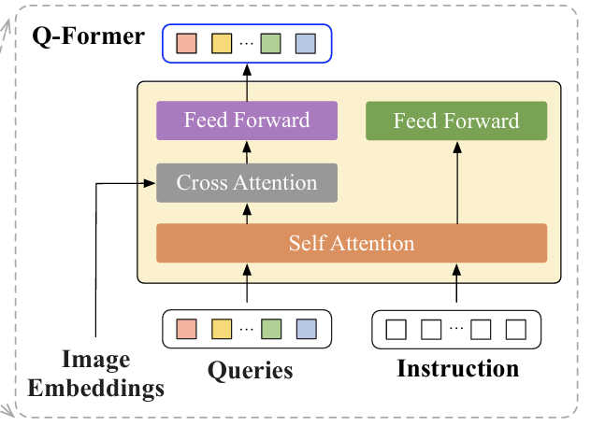
The Bridge (Q-Former)
What goes into the Q-Former
Image embeddings (from frozen Vision Encoder).
A set of 32 learnable query tokens.
Instruction tokens – the prompt (this is the InstructBLIP extension: instruction-aware Q-former).
What are “Query Tokens”?
They are trainable vectors (like 32 special tokens) whose job is to pull useful info from the image tokens through cross-attention.
Q-Former - What It Does
Self-attention over (queries + instruction tokens) - allowing the model to "understand" the task so that the queries know exactly which visual details to look for, in the image.
Cross-attention where queries attend to vision tokens - act like scouts to find and collect only the specific parts of the image needed to answer the question.
FFN is about processing the output of the attention layer, make sure it is ready and useful for the next stage of the model. (in a way that make the data smarter)
Notes:
Chen The Q-Former is the “information extractor” between vision and language

Slide 13
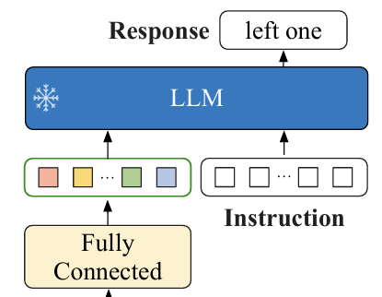
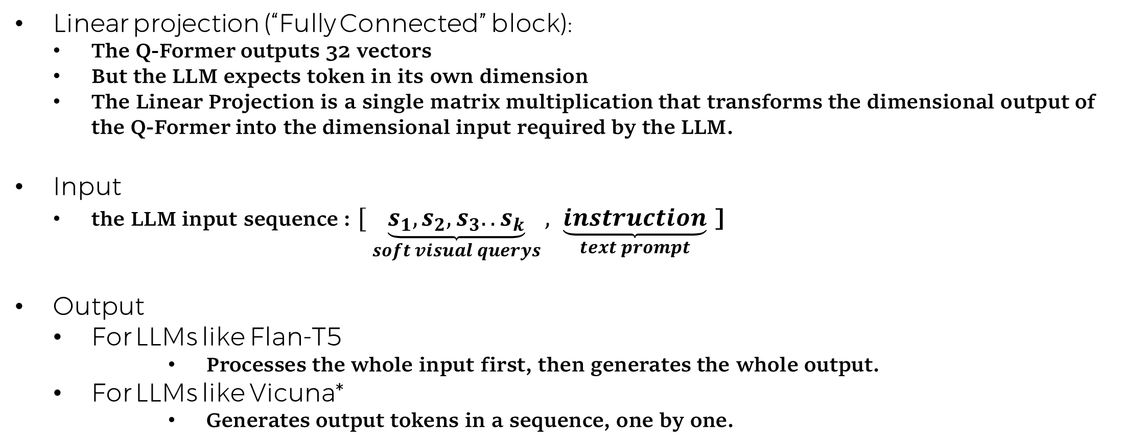
The Large Language Model
Linear projection (“Fully Connected” block):
The Q-Former outputs 32 vectors
But the LLM expects token in its own dimension
The Linear Projection is a single matrix multiplication that transforms the dimensional output of the Q-Former into the dimensional input required by the LLM.
Input
the LLM input sequence : $[ \underset{soft visual querys}{\underbrace{s_{1},s_{2},s_{3}..s_{k}}}, \underset{text prompt}{\underbrace{instruction}}$ ]
Output
For LLMs like Flan-T5
Processes the whole input first, then generates the whole output.
For LLMs like Vicuna*
Generates output tokens in a sequence, one by one.
Notes:
Chen
Apparently, in phase B we will use Vicuna
because is an open-source LLM that is available for free, and it is considered one of the most popular models in the AI community.

Slide 14
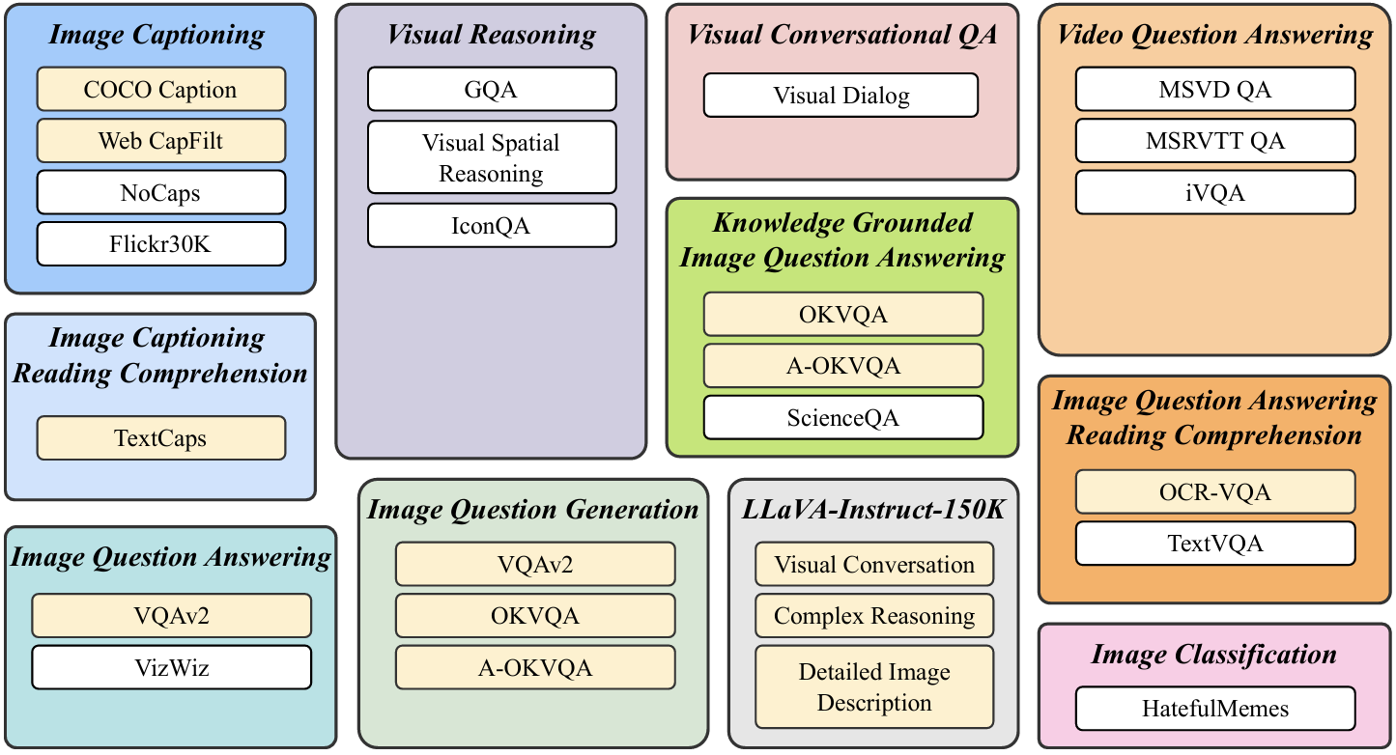
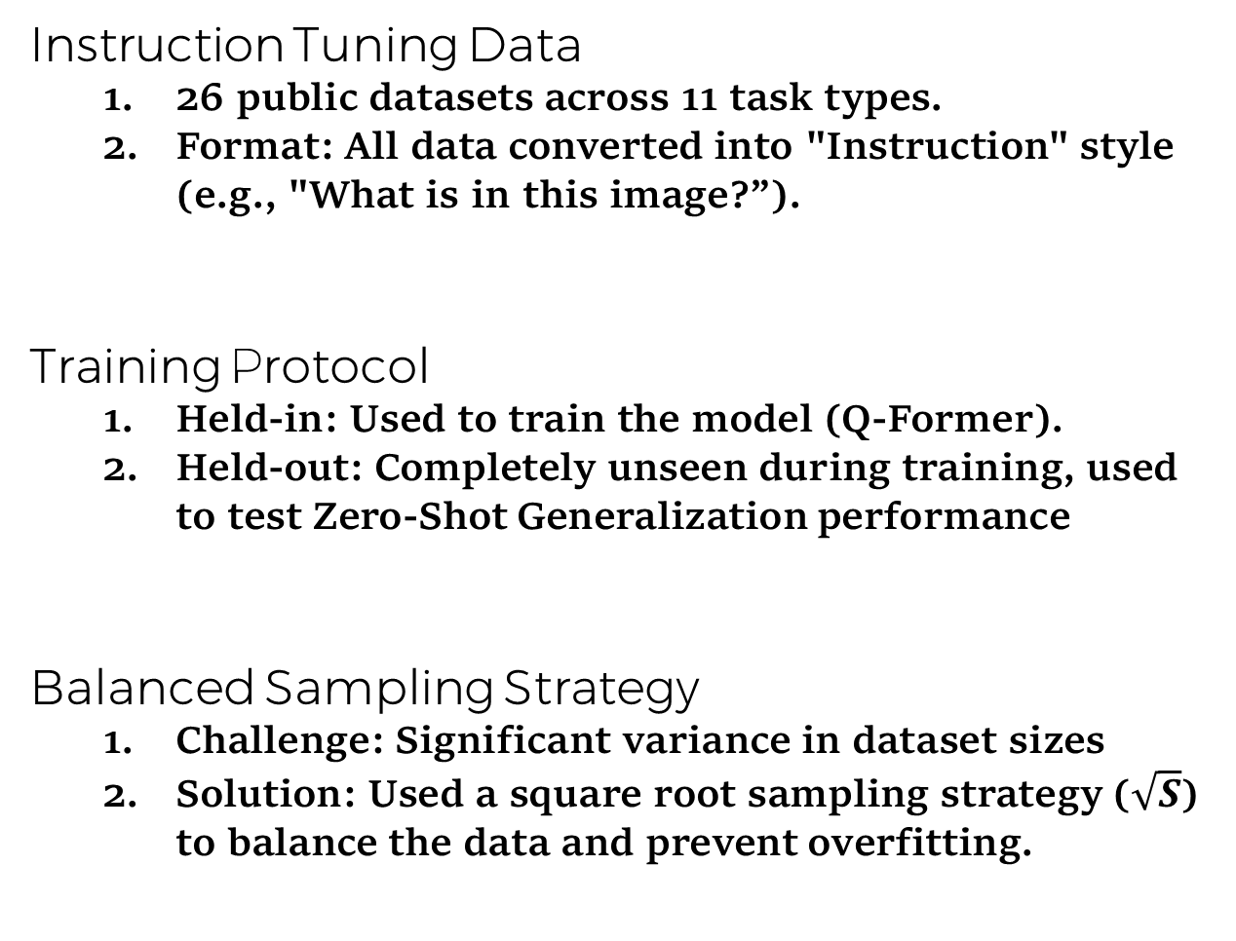
InstructBLIP Training Strategy
Instruction Tuning Data
26 public datasets across 11 task types.
Format: All data converted into "Instruction" style (e.g., "What is in this image?”).
Training Protocol
Held-in: Used to train the model (Q-Former).
Held-out: Completely unseen during training, used to test Zero-Shot Generalization performance
Balanced Sampling Strategy
Challenge: Significant variance in dataset sizes
Solution: Used a square root sampling strategy ($\sqrt{S}$) to balance the data and prevent overfitting.
Held in – yellow Held out - White
Notes:
Intro: "Now, let's look at how we actually trained the model. This strategy is what makes InstructBLIP so special.“
1. Instruction Tuning Data: "First, the data. We didn't just use images. We took 26 different datasets from 11 different task types. But here is the key: We converted all of them into an 'Instruction' format. Instead of just showing an image, we ask the model questions like 'What is in this image?' or 'Describe the scene'. This teaches the model to follow user commands."
2. Training Protocol (The Diagram): "Please look at the diagram on the right.
The Yellow boxes are what we call 'Held-in' data. We used these to train the Q-Former.
The White boxes are 'Held-out' data. The model never saw these during training. We use them to test the model's Zero-Shot ability—meaning, can it solve problems it has never seen before?"
3. Balanced Sampling Strategy: "Finally, we had a challenge: Some datasets are huge (like COCO), and some are very small. If we train normally, the model only learns the big ones. So, we used a Square Root Sampling strategy. This is a math trick that balances the big and small datasets, so the model learns from everything equally and doesn't overfit."
במה משתמשים בתוצאה? (ההסתברות) התוצאה של השורש קובעת את ההסתברות שהמערכת "תשלוף" דוגמה מהדאטה-סט הזה בכל צעד של האימון. הנוסחה המדויקת מהמאמר היא: ההסתברות לבחור בדאטה-סט די שווה לשורש הגודל שלו, חלקי סכום השורשים של כולם

Slide 15
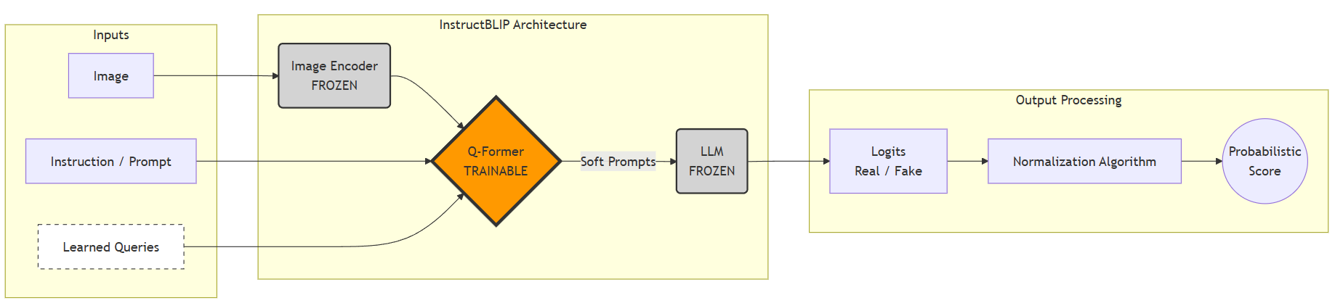
System Workflow Turning a Chatbot into a Detector
Step 1 - The Input: Standard Image (I) + Fixed Prompt (Q): “Is this photo real?”.
Step 2 - The bridge: Q-Former extracts visual features specifically to answer the prompt.
Step 3 - The Innovation (token Probabilities Extraction): Instead of generating text ("Yes/No"), we access raw token probabilities.
Step 4 - The Output: Result: A precise Anomaly Score (0-1) for AUC calculation.
Notes:
Nir
"Please take a look at the system architecture diagram. This illustrates our core innovation: transforming a generative model into a probabilistic classifier.
1. On the left, you see the input. We feed the model the image along with a specific question: 'Is this photo real?'.
2. In the middle, the Q-Former processes the image based on that question. It acts as a bridge, extracting only the visual cues relevant to forgery detection.
3. Now, look at the output stage. A standard VLM would just generate the text 'Yes' or 'No'. But text is binary and hard to measure.
4. Instead, we intercept the process before text generation. We extract the raw confidence scores—the logits—for the tokens 'Yes' and 'No'.
5. Finally, using the formula you see on the screen, we normalize these scores to get a precise probability. This gives us a continuous anomaly score, allowing us to build a robust security system."

Slide 16
Testing Plan
Unit Under Test | Test Case | Input | Expected Output
SBI Module | SBIModelLoad | Path to the pre-trained SBI weights (EfficientNet-b4). | The SBI model loads to memory ready for inference.
SBI Module | SBIBoundaryCheck | A final Self-Blended Image (SBI) after processing. | An image tensor of exact dimensions (224 X 224) with no visible artifacts at the borders.
SBI Module | SBIInference | A standard image tensor (preprocessed for SBI). | A single float prediction score representing the probability of the image being fake.
InstructBLIP Module | InstructBLIPModelLoad | Model configuration path and weights (InstructBLIP). | The Model and Processor objects initialized in GPU/CPU memory ready for inference.
InstructBLIP Module | InstructBLIPImagePrompting | An image and the prompt "Is this photo real?". | The model outputs a text response containing relevant tokens ("Yes"/"No“) with explanations.
Inference Pipeline | Zero-Shot Detection Flow | A dummy image (tensor) and the standard deepfake prompt. | A single float value (0.0 to 1.0) representing the "Fakeness" confidence score without errors.
Evaluation Module | CompareModels | Results from both InstructBLIP and SBI on the same batch. | A comparison output showing which model performed better (Accuracy). we expected that InstructBLIP with zero-shot will be better from SBI.
Notes:
Chen This slide describe our Test Plan. Before we can compare the results, we need to make sure both systems work correctly.
We divided the tests into three parts:
First, the SBI Model: This is the specialized deepfake detector. We test if it loads correctly and if it processes the images without creating technical errors at the borders.
Second, InstructBLIP: Here, we test our Zero-Shot pipeline. We need to verify that when we ask 'Is this photo real?', the model gives us a valid answer that we can convert into a mathematical score.
Finally, the Comparison: Once both pipelines are stable, we run them on the same images.
Our Prediction is that InstructBLIP, using its general knowledge will actually perform better than the specialized SBI model, especially on difficult images."

Slide 17


